Slide 1
Unit 2:
MY HOME
Lesson 6. SKILLS 2

Slide 2
* Checking the previous lessons:
This is my house. There …

Slide 3
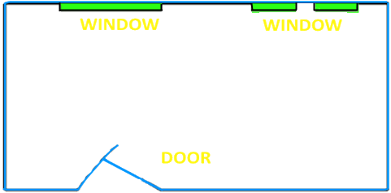
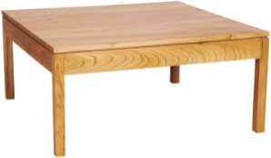
* LISTENING:
1. Nick’s parent are describing their room at the hotel. Listen and draw the furniture in the correct place.
shelf
wardrobe
table
fireplace
stool
sofa
bed

Slide 4
Audio Scripts
Nick’s Mum: Nick’s staying in the Tiger room. We’re staying the Bear room. There’s a big bear near the door. The bear is actually the fireplace. In the far corner, there is a window. The shelves are right in front of it. Next to the shelves is a big bed. There’s a wardrobe next to the bed.
Nick’s Dad: Oh, there are also two other windows in the room. In front of these windows, there’s sofa, a table and two stools. We like the room because it’s comfortable.

Slide 5
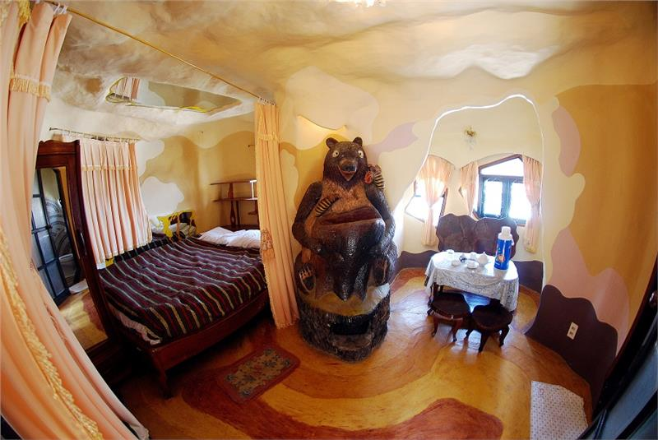
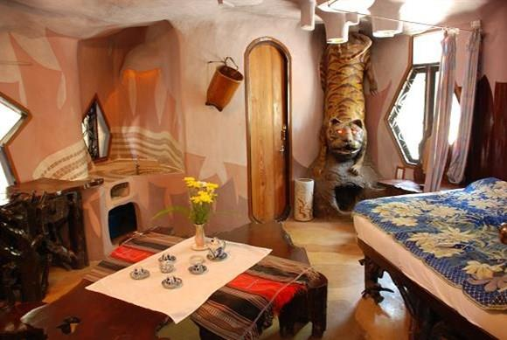
Bear room
Tiger room

Slide 6
2. Read Nick's e-mail again. Identify the subject, greeting, introduction, body and conclusion of the e-mail.
Subject
Greeting
Introduction
Body
Conclustion

Slide 7
An e-mail to a friend
* WRITING:
Writing Tip - How to write an e-mail to a friend.
In the subject line, writing briefly what the e-mail is about.
Begin the e-mail with greeting (Dear / Hi / Hello...)
The introduce is the first paragraph. We can ask about her / his health, thank him / her for the previous e-mail or write the reason for e-mail, etc.
In the body, write the subject(s) of the e-mail. Write each subject in a new paragraph.
The conclusion is the last paragraph. It includes the closing remarks: saying goodbye, asking your friend to write back, sending your regards to his / her family, etc…

Slide 8
REVIEW: punctuation
1. Capital letters
- Starting a sentence: When we are free….
- Proper names: David, Ba….
- Days and months: Monday, September….
- Pronoun: I, She, He….
- Places: London, Ha Noi….
2. Commas (,): To separate long sentences and lists of things
She has a book, a pen, a pencil and an ruler.
3. Full stops (.), question marks (?), or exclamation mark (!): They are put at the end of the sentences.
We are learning English.
Are you a student?
What a nice girl!

Slide 9
3. Read the e-mail below and correct it. Write the correct version in the provided.
From: mi@fastmail.com
To: sophia@quickmail.com
Subject: My house.
hi sophia
thank for your e-mail now i’ll tell you about my house, i live with my parents and younger brother in a town house it's big. there are six rooms: a living room, a kitchen, two bedrooms and two bathrooms i like my bedroom best, we’re moving to an apartment soon. what about you? where do you live? tell me in your next e-mail.
best wishes.
Mi

Slide 10
Suggested correct version of the e-mail.
From: mi@fastmail.com
To: sophia@quickmail.com
Subject: My house.
Hi Sophia.
Thank for your email. Now, I’ll tell you about my house. I live with my parents and younger brother in a town house. It's big. There are six rooms: a living room, a kitchen, two bedrooms and two bathrooms. I like my bedroom best. We're moving to an apartment soon.
What about you? Where do you live? Tell me in your next e-mail.
Best wishes,
Mi.

Slide 11
4. Write an e-mail to Nick. Tell him about your idea for the new room of the Crazy House Hotel.
Plan
Brainstorm vocabulary about your room.
Draft
Write a draft.
Check
Check your draft:
Is the punctuation correct?
Is the capitalization correct?
Does it have all necessary parts?

Slide 12
Suggested an e-mail to Nick, tell him about your idea for the new room of the Crazy House Hotel.
From: Phong@fastmail.com
To: Nick@quickmail.com
Subject: The new room of the Crazy House Hotel
Hi, Nick
I received your e-mail last night. I think your room at the Crazy House Hotel is very messy and uncomfortable. You should move to another room.
In the new room, there are two windows. There is a sofa with a table and two stools in front of one window. There is a big bed in front of the other window. There is a fireplace next to the door. There is a wardrobe next to the bed and the shelf next to the wardrobe. On the wall next to your bed, there is a map of Viet Nam and a beautiful picture of Prenn Waterfall.
I think you will like it. It's great, is’t it?
See you soon!
Phong.

Slide 13
HOMEWORK
Listen to the recording in the listening part again.
Review: Punctuation.
Memorize the way to write an email.
Do exercise in workbook (page 15).

